Slide 1

AtliQ Grands-Hospitality Analysis
By
Fathima Ashraf

Slide 2
Company Overview
AtliQ Grands is a leading hospitality company operating multiple five-star hotels across India
Over 20 years of experience in the hospitality industry
Focuses on luxury and business hotel segments
Strong presence in major cities: Delhi, Mumbai, Hyderabad, and Bangalore
Known for premium customer experience and high-quality services
Offers multiple room categories: Standard, Elite, Premium, and Presidential

Slide 3

Problem Statement
AtliQ Grands, a five-star hotel chain across India, has been losing its market share and revenue due to increased competition and ineffective management decisions. To address this, the company decided to incorporate Business and Data Intelligence to improve decision-making.

Slide 4

Project Objectives
Develop business metrics based on stakeholder requirements
Design dashboards aligned with mock-ups
Generate additional insights beyond the given metric list

Slide 5
Solution Approach 1.Data Collection
Data was sourced from multiple CSV files:
dim_date.csv
dim_hotels.csv
dim_rooms.csv
fact_bookings.csv
fact_aggregated_bookings.csv

Slide 6
2.Data Transformation
Performed in Power Query:
Removed nulls and duplicates
Standardized data formats
Merged and appended tables for consolidated analysis

Slide 7
3.Data Modeling
Built a Star Schema model to ensure optimized performance and easy DAX calculation.
Dimension Tables:
dim_hotels: Hotel details (property name, city, category)
dim_rooms: Room details (room class)
dim_date: Date attributes (day type, month, week number)
Fact Tables:
fact_bookings: Booking-level data (revenue, ratings, guests, booking platform)
fact_aggregated_bookings: Aggregated capacity and successful bookings

Slide 8
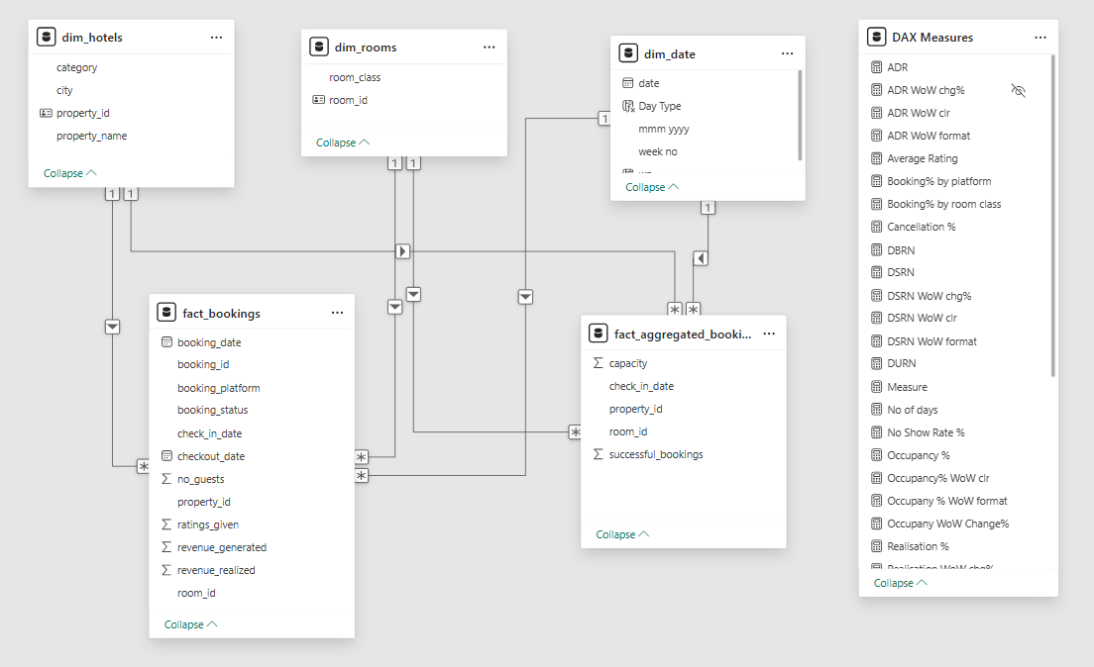

Slide 9
4.DAX & Calculated Columns
Key measures created using DAX:
ADR (Average Daily Rate)-Measures the average revenue earned per booked room during a specific time period.
DSRN (Daily Successful Room Nights)-Indicates the average number of rooms available for sale per day during a given period.
DBRN (Daily Booked Room Nights)-Represents the average number of rooms booked per day over a specific time period.
DURN (Daily Utilized Room Nights)-Shows the average number of rooms successfully utilized by customers per day.
RevPAR (Revenue per Available Room)-Measures the revenue generated per available room and helps evaluate overall hotel revenue performance.
Occupancy %-– Indicates the percentage of available rooms occupied by customers during a given period
Realisation %-Represents the percentage of successful check-outs compared to total bookings made.
Cancellation %-Shows the percentage of bookings canceled out of the total bookings received.
No Show Rate %-Indicates the percentage of customers who booked rooms but did not check in.

Slide 10

5.Dashboard development
An interactive Power BI dashboard was built with navigation, filters, and tooltips for seamless exploration.
Structured the dashboard into three key views—Executive View, Revenue Insights, and Booking Insights—where the Executive View provides a high-level KPI summary, Revenue Insights focuses on performance trends and Booking Insights analyzes occupancy patterns and booking behavior.

Slide 11
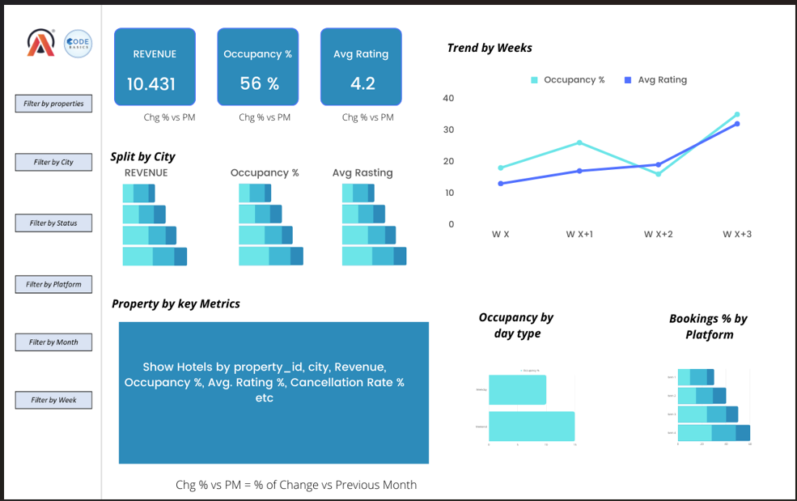

Slide 12
Click here to view the dashboard

Slide 13
Insights

Slide 14
Executive View
Delhi achieved the highest average customer rating (~3.8) and occupancy rate (~60%), indicating strong customer satisfaction and booking efficiency.
Bangalore recorded the lowest occupancy (~55.8%) and average rating (~3.4), highlighting the need for service and demand improvement.
Weekend occupancy (~52.8%) was higher than weekday occupancy (~47.2%), showing stronger leisure travel demand during weekends.
AtliQ Exotica generated the highest revenue (~212M) with strong occupancy performance among all properties.
Several Bangalore and Hyderabad properties reported higher cancellation rates (~25–26%), negatively affecting realized revenue.
Revenue realization remained stable around ~70%, reflecting effective conversion of bookings into revenue despite cancellations.
Occupancy peaked during Week 32 (~65%), while Weeks 29–30 showed noticeable dips close to ~50%.
Properties with higher occupancy did not always generate the highest revenue, indicating differences in pricing strategy and ADR across locations.

Slide 15
Revenue Insights
• Mumbai generated the highest revenue (~669M), followed by Bangalore (~420M), making them the top revenue-contributing cities.
• Revenue remained stable between Weeks 19–31 (~115M–140M) before dropping sharply in Week 32 (~27M).
• Week 22 recorded the highest weekly revenue (~139M), indicating peak booking demand during that period.
• Business category rooms generated significantly higher revenue (~1053M) compared to luxury category rooms (~656M).
• Weekday bookings contributed nearly 70% of total revenue (~1185M), reflecting strong business and corporate travel demand.
• The “Others” booking platform contributed the highest revenue (~699M), showing heavy dependence on third-party booking channels.
• Direct online and offline channels generated comparatively lower revenue, highlighting opportunities to improve direct bookings.
• ADR remained stable around ~12K–13K across most weeks, while occupancy fluctuations impacted RevPAR performance.
• AtliQ Exotica, AtliQ Palace, and AtliQ City emerged as the top 3 revenue-generating properties.

Slide 16
Booking Insights
• Mumbai contributed the highest total bookings (~43K), significantly outperforming Hyderabad, Bangalore, and Delhi.
• Business category bookings (~84K) were higher than luxury bookings (~51K), indicating stronger demand from business travelers.
• Total successful bookings remained consistently between ~9K–11K across most weeks before dropping sharply in Week 32.
• Cancellation volume remained stable but continued to impact occupancy and revenue realization.
• The “Others” platform accounted for ~40% of total bookings, showing strong reliance on third-party booking platforms.
• Direct booking platforms contributed less than 15% combined, highlighting opportunities to improve brand-owned booking channels.
• Occupancy across all room classes remained balanced between ~57%–59%, with Premium and Elite categories performing slightly better.
• AtliQ Blu Mumbai recorded one of the highest occupancy rates (~66%), while AtliQ Grands Bangalore showed the lowest (~44%).
• Several properties maintained high booking volumes despite higher cancellation rates (~24–26%), indicating strong demand but lower booking retention.
• No-show rates remained consistently low ,reflecting efficient reservation management.

Slide 17

Recommendations
Focus promotional campaigns in Delhi to improve booking volume and market performance.
Strengthen partnerships with high-performing third-party platforms while encouraging more direct bookings to improve profitability.
Introduce targeted offers during low-performing weeks to reduce seasonal revenue fluctuations.
Improve customer experience and service quality in lower-rated cities to enhance guest satisfaction and occupancy.
Expand and prioritize Luxury and premium room offerings, as they contribute the highest share of revenue and bookings.
Implement strategies to reduce cancellation rates, such as flexible pricing, loyalty benefits, and early confirmation offers.
Maximize the strong performance of AtliQ Palace (Delhi) as a benchmark for operational and service improvements across other properties.
Increase weekend-focused marketing campaigns and leisure packages to improve weekend occupancy and revenue generation.

Slide 18
Conclusion
The analysis shows that Mumbai emerged as the top-performing city in terms of revenue and bookings, while Delhi achieved strong occupancy and customer ratings. Luxury properties and premium room categories contributed the highest share of revenue, highlighting strong demand for high-end hospitality services. Third-party booking platforms played a major role in driving bookings and overall revenue generation. Although ADR remained stable, fluctuations in occupancy and revenue indicate seasonal demand variations across different weeks. Overall, the insights highlight opportunities for AtliQ Grands to improve customer experience, reduce cancellations, and strengthen revenue growth through data-driven business strategies.

